Slide 1
Chips Sales Data
Collins Jahwi

Slide 2
AGENDA
Introduction
Sales by packet size
Customer total sales
Sales Distribution across life stages
Customer types
Transactions per Brans
Sales Distribution Across brands per Customer
Conclusion

Slide 3
INTRODUCTION
A Summary of customer buying behavior over a 1-year period. An analysis of types of customers who purchase chips and their behavior within the region. I looked at packet sizes, total sales by demographics such as incomes and household make up. I also looked at which brands had the most sales.

Slide 4
Sales by package Sizes

Slide 5
Customers Total Sales Demographics
No | Life Stage | Premium Customer | Total Sales
1 | OLDER FAMILIES | Budget | 156863.75
2 | YOUNG SINGLES/COUPLES | Mainstream | 147582.20
3 | RETIREES | Mainstream | 145168.95
4 | YOUNG FAMILIES | Budget | 129717.95
5 | OLDER SINGLES/COUPLES | Budget | 127833.60
6 | OLDER SINGLES/COUPLES | Mainstream | 124648.50
7 | OLDER SINGLES/COUPLES | Premium | 123537.55
8 | RETIREES | Budget | 105916.30
9 | OLDER FAMILIES | Mainstream | 96413.55
10 | RETIREES | Premium | 91296.65

Slide 6
Customers Total Sales Demographics
No | Life Stage | Premium Customer | Total Sales
11 | YOUNG FAMILIES | Mainstream | 86338.25
12 | MIDAGE SINGLES/COUPLES | Mainstream | 84734.25
13 | YOUNG FAMILIES | Premium | 78571.70
14 | OLDER FAMILIES | Premium | 75242.60
15 | YOUNG SINGLES/COUPLES | Budget | 57122.10
16 | MIDAGE SINGLES/COUPLES | Premium | 54443.85
17 | YOUNG SINGLES/COUPLES | Premium | 39052.30
18 | MIDAGE SINGLES/COUPLES | Budget | 33345.70
19 | NEW FAMILIES | Budget | 20607.45
20 | NEW FAMILIES | Mainstream | 15979.70
21 | NEW FAMILIES | Premium | 10760.80

Slide 7
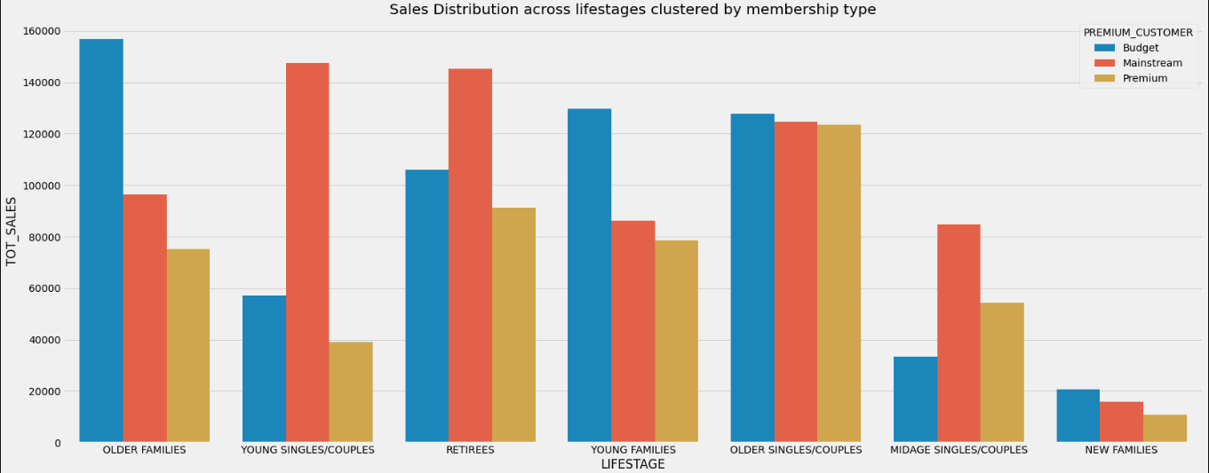
Sales distribution Across Life stages clustered membership type

Slide 8
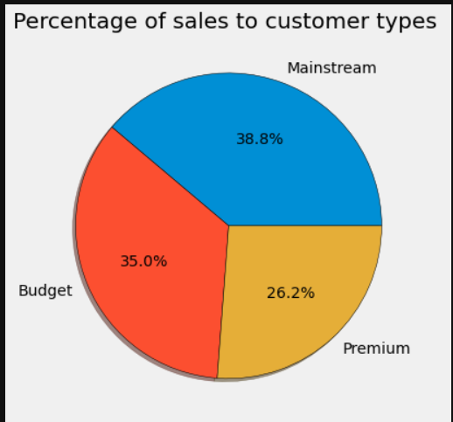
Percentage of sales to customer Groups

Slide 9
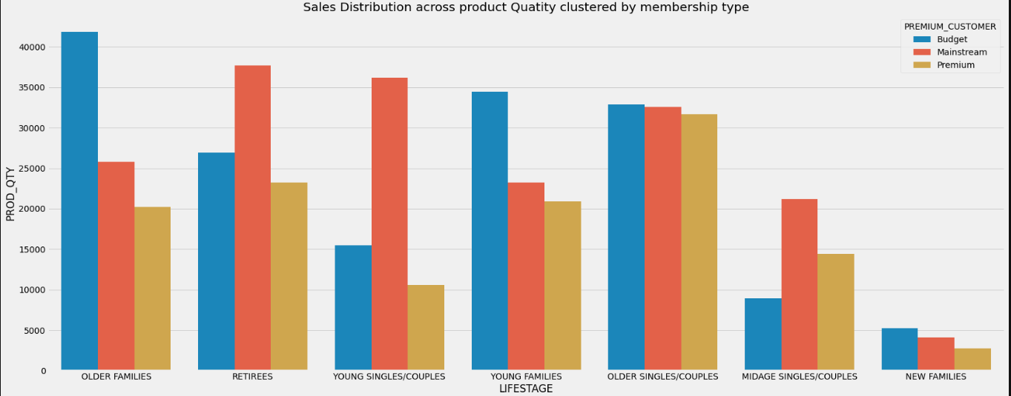
Sales Distribution by product Quantity Clustered by Membership Type

Slide 10
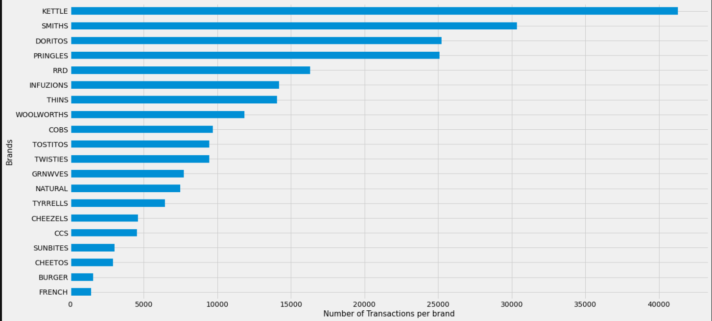
Number of Transactions per Brand

Slide 11
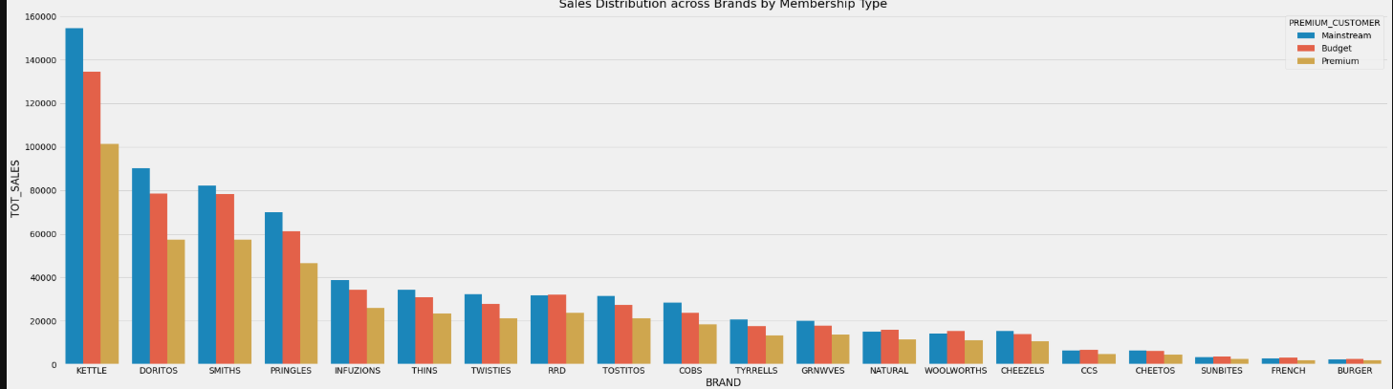
Sales Distribution across Brands by Membership type

Slide 12
Conclusion
Customer groups
Packet Size
The older customers have higher purchases than the other groups.
Of the 3 premium customer the mainstream also spend more than the premium and ​​​budget customers
The smaller packet sizes do not have good sales numbers it seems the average sized packets sell more

Slide 13
THANK YOU
Collins Jahwi
coja1@outlook.com

